Slide 1
Search Engines
Full text search inside documents

Slide 2
Why Search Engines
Traditional searches do not use SEO
Traditional searches do not perform Crawling and indexing

Slide 3
Full text search engines available in market
Streaming Data into Amazon
Elastic search using kibana for data visualization
Redisearch

Slide 4
Streaming Data into Amazon Elasticsearch Service
It will work with a lambda function to make sure any new data sent to an S3 bucket triggers an event notification to this Lambda and update the ES index.
Documentation is very good
At a high level, setting up to stream data to Amazon ES requires the following steps:
Creating an Amazon S3 bucket and an Amazon ES domain
Creating a Lambda deployment package.
Configuring a Lambda function.
Granting authorization to stream data to Amazon ES.

Slide 5
Elastic search using kibana for data visualization
Elastic search is fast search engines which uses SEO and indexing
Very good tool available i.e. Can use kibana for data visualization
Very good documentation
Well connected with amazon AWS services

Slide 6
Demo 1: Search document by index stored

Slide 7
Demo 1: Full text Search/Fully Rest API support

Slide 8
RedisSearch
Redisearch implements a search engine on top of Redis, but unlike other Redis search libraries, it does not use internal data structures like sorted sets.
This also enables more advanced features, like exact phrase matching and numeric filtering for text queries, that are not possible or efficient with traditional Redis search approaches.
Fewer documentation online
Cloud version provide support for the Amazon AWS and google cloud
Support autocomplete

Slide 9
Redisearch running on unix based system

Slide 10
Redisearch phrase search and FTS

Slide 11
Redisearch and encrypted content
Store primary data in encrypted data store i.e. s3 bucket
Implement redisearch with NOINDEX option
Redisearch only need to store the inverted index

Slide 12
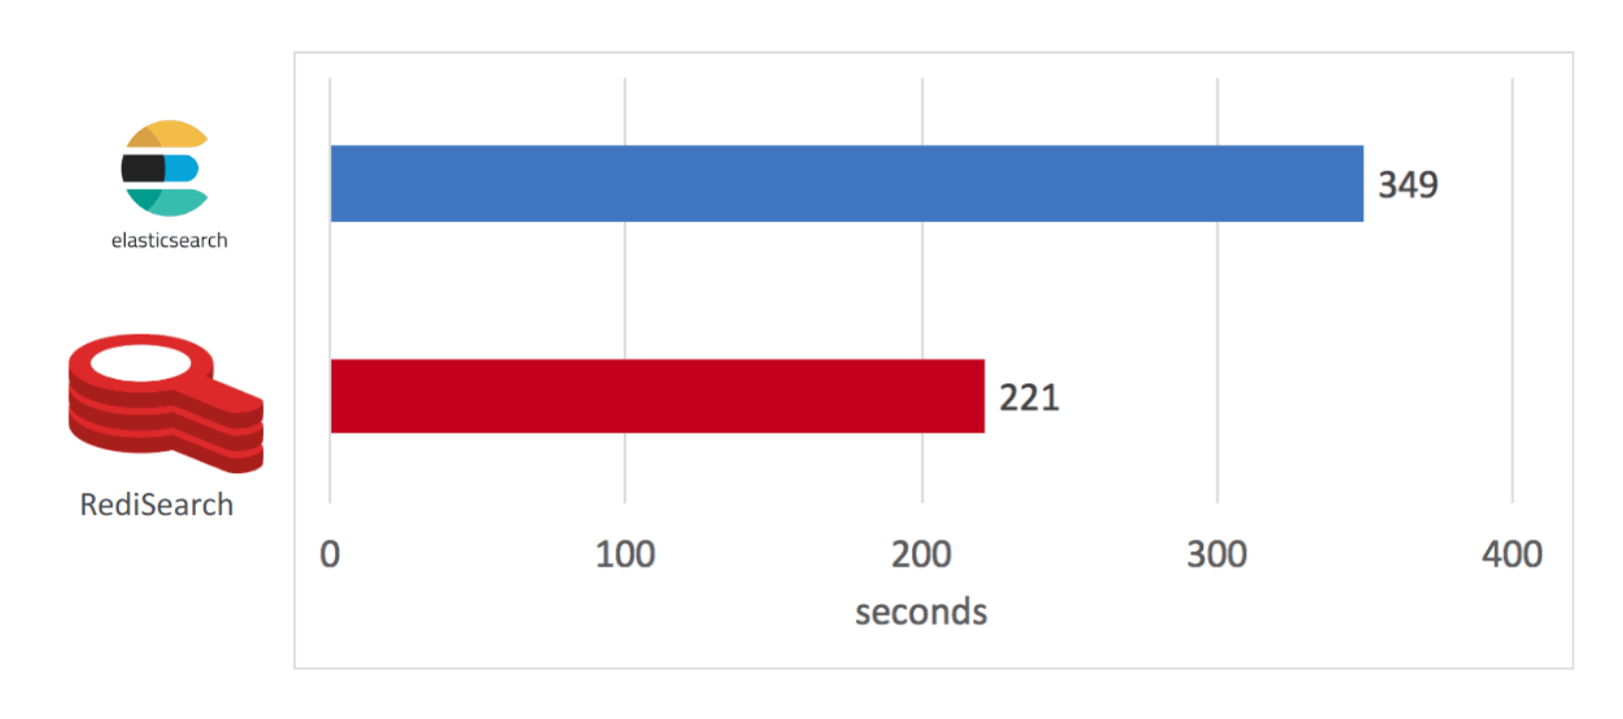
RediSearch vs ElasticSearch benchmark
Indexing results - RediSearch built its index in 221 seconds versus 349 seconds for Elasticsearch, or 58% faster.

Slide 13
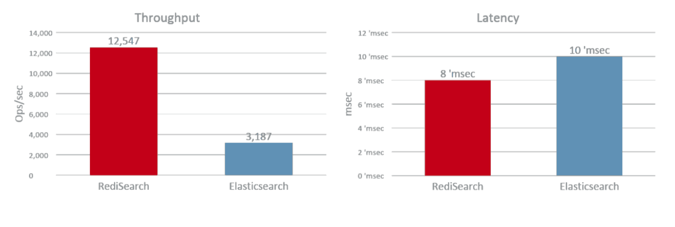
RediSearch vs ElasticSearch benchmark Querying results

Slide 14
Conclusion
Best suited based on the requirement in projects
Compatibility
Documentation

